Slide 1
Inspection Principle

Slide 2
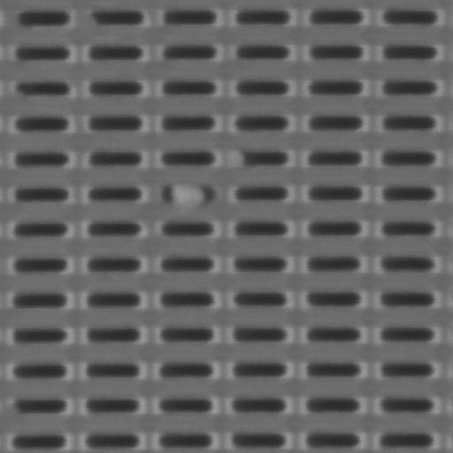
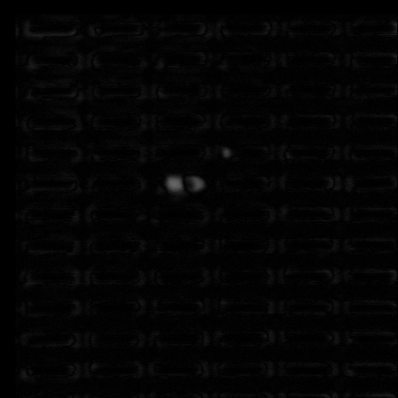
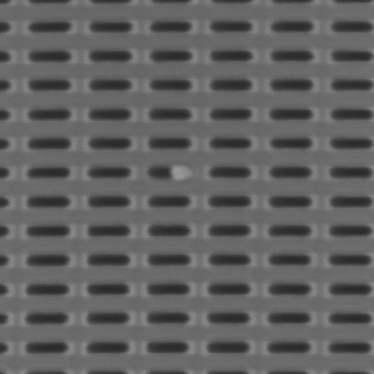
Inspection Principle
What is Inspection
Inspection purpose is to find all abnormal pixel points from scanning image.

Slide 3
Inspection Principle
Inspection Mode:
Array Mode
Random Mode
Normal Random Mode
Reference1 Random Mode
Reference2 Random Mode
Hybrid Mode
Normal Hybrid Mode
Reference1 Hybrid Mode
Reference2 Hybrid Mode

Slide 4
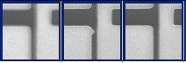
Inspection Principle
Normal Random Mode:
Image
Alignment
Detection
Defets
Column/Stripe Image From three dies

Slide 5
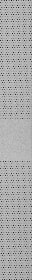
Inspection Principle
Array Mode:
Array Mode is a special random mode. Reference Image is the image which is shifted a +period and –period.

Slide 6
Inspection Principle
Reference1 Random Mode:
Two Reference Images are from same fixed die’s image.
Reference2 Random Mode:
Two Reference images are from same fixed two die’s image.

Slide 7
Inspection Principle
Hybrid Mode:
Care area will be separated into random area, array area and mask area. For random area, we will do die-to-die random mode, for array area, we will do normal array mode based on period shift. For mask area, we will not do anything.
For Example:
Blue Area: Random Area
Green Area: Array Area
Yellow Area: Mask Area
For hybrid mode, Random area and Array area can select different inspection parameter.
For overlap area of array & random, based on priority, the latter the area group, the higher of the priority

Slide 8
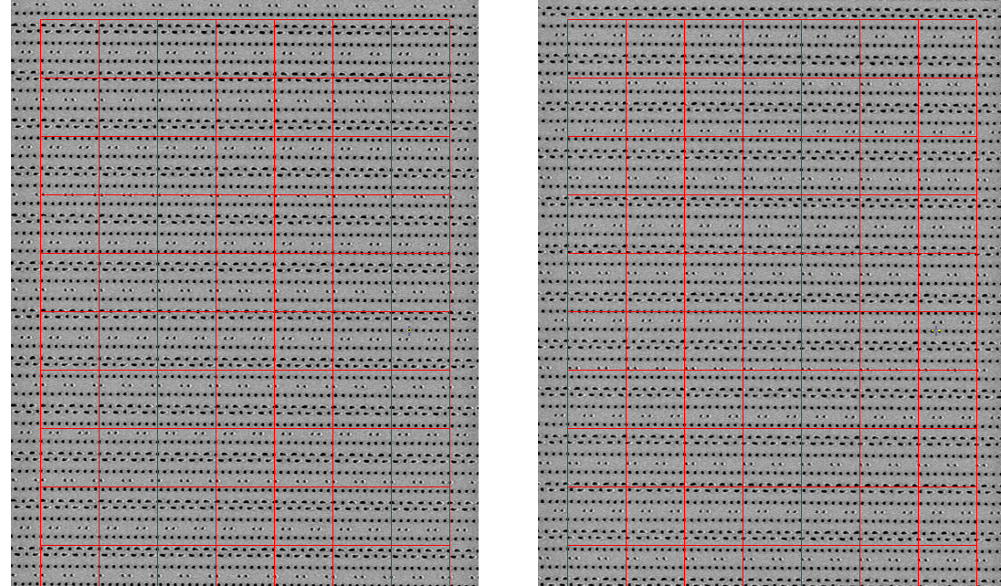
Inspection Principle
What is image alignment.
When two images have position shift or image scale change, we have to align these two images to make sure these two images’ every pixel is one to one match.

Slide 9
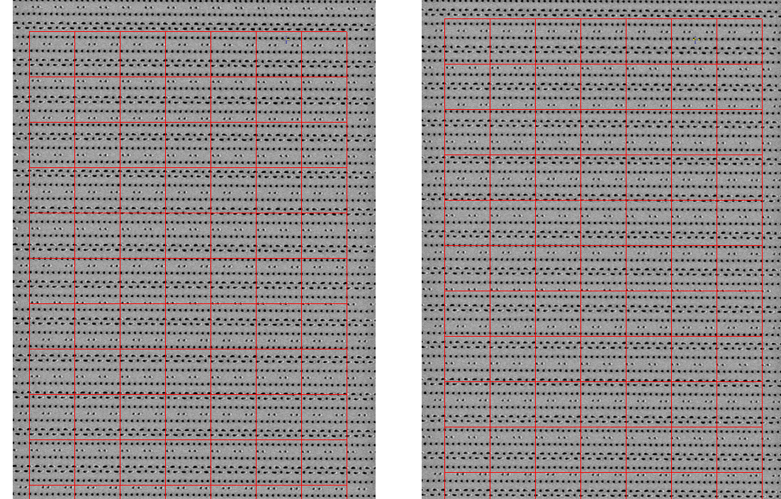
Inspection Principle
image alignment.

Slide 10
Inspection Principle
How to implement image alignment.
Global Alignment
Local Alignment
Local Alignment
Refine

Slide 11
Inspection Principle
What is Detection.
Reference Image
I₁(i,j)
i=0,m, j = 0,n
Defect Image
I₂(i,j)
i=0,m, j = 0,n
Reference Image
I₃(i,j)
i=0,m, j = 0,n
I₂₁: I₂₁(i, j) = I₂(i, j)-I₁(i, j)
I₂₃: I₂₃(i, j) = I₃(i, j)-I₂(i, j)
When dI > T, (i,j) pixel will be defined as a defect. T as threshold.

Slide 12
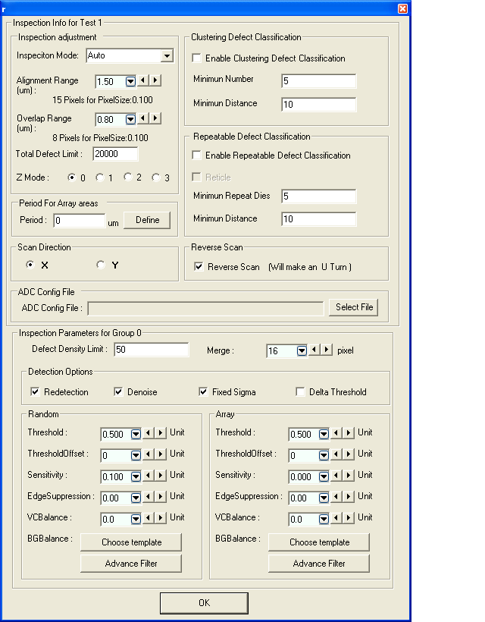
Inspection Principle
Inspection Parameters:
Threshold
Threshold Offset
Sensitivity
Edge Suppression
VC Balance
BG Balance
Detection Option:
fixed sigma, denoise, redetection etc
Alignment Range
Special Filter Kernel effect

Slide 13
Inspection Principle
Inspection Parameters:
Threshold
Threshold Offset
Pixel Number
σ
T*σ
T*σ+Toffset
Delta Graylevel

Slide 14
Inspection Principle
3. Sensitivity
3. 1 What is sensitivity
Sensitivity means how detection code treat defect with different size and strength. When sensitivity is high, it means detection code will be sensitive to more small defect, it also be sensitive to noise. When sensitivity is low, it means detection code will not be sensitive to small defect, it will reduce single noise’s false defect.
0.0
1.0
Less Sensitive
More
Blur Image
Less Defects
more Sensitive
Less
Blur Image
More Defects

Slide 15
Inspection Principle
3. Sensitivity
3. 2 How to implement sensitivity
In eScan310/eScan380, we use 5X5 filter kernel to implement Sensitivity.
1 | 1 | 1 | 1 | 1
1 | 1 | 1 | 1 | 1
1 | 1 | 1 | 1 | 1
1 | 1 | 1 | 1 | 1
1 | 1 | 1 | 1 | 1
1 | 1 | 1 | 1 | 1
1 | 2 | 3 | 2 | 1
1 | 3 | 4 | 3 | 1
1 | 2 | 3 | 2 | 1
1 | 1 | 1 | 1 | 1

Slide 16
Inspection Principle
3. Sensitivity
3. 3 Image effect for different sensitivity
0.0
0.5
1.0

Slide 17
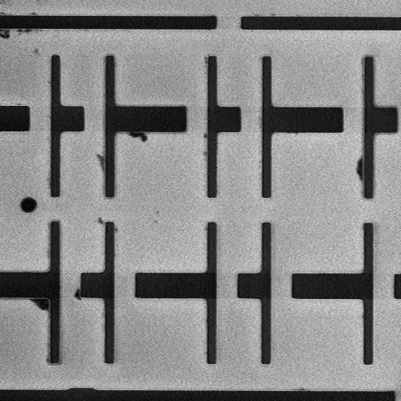
Inspection Principle
3. Sensitivity
3. 3 Image effect for different sensitivity
0.5

Slide 18
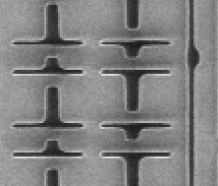
Inspection Principle
4. Edge Suppression
4. 1 What is edge suppression
Edge suppression means that we will suppress all edge pixel gray level based on edge’s gradient. SEM Image’s edge noise is bigger than flat area. So we need to suppress edge’s area noise level to reduce edge related false defect.
SEM Image
Image suppressed
Pattern with sharp edge

Slide 19
Inspection Principle
4. Edge Suppression
4.2 How to suppress edge
In Image, edge area will be decided by edge gradient:
dx = I_{x+1} – I_{x} and dy = I_{y+1} – I_{y}
When image noise level is n, all dx > 2n and dy > 2n area will be edge area.
For edge area, We will suppress pixel graylevel based on dx and dy.
I_{new} = I_{old}*rate(dx, dy)

Slide 20
Inspection Principle
4. Edge Suppression
Edge suppression rate from 0 to 1
Edge Suppression rate
1.0
0
255
Edge gradient
Edge suppression parameter will affect rate(dx, dy)’s curve.
When edge suppression parameter is as 0, we will use flat curve for all gradient. It means there are no any edge suppression for all gradient.
When edge suppression parameter increase, we will use suppression curve for all gradient. Bigger gradient will have more smaller rate. It means we will suppress more edge’s gray level value.

Slide 21
Inspection Principle
5. VC Balance
Balance DVC and BVC output. When DVC and BVC have different sensitivity, we can control DVC and BVC defect output. DVC and BVC will have different threshold.
Pixel Number
σ
T*σ
T*σ+Toffset
Delta Graylevel

Slide 22
Inspection Principle
5. VC Balance
VC Balance Parameter:
-1 ~ 0: Don’t affect any DVC, just affect BVC
DVC’s threshold Keep same.
BVC’s threshold will become bigger:
T _{new}= T/(1+p).
0 ~ 1: Don’t affect any BVC, just affect DVC
BVC’s threshold Keep same.
DVC’s threshold will become bigger:
T new= T/(1-p).

Slide 23
Inspection Principle
6. BG Balance
Background balance is used to control different gray level range’s sensitivity. If we don’t like some gray level range’s defect, we can use BG balance to filter it out.
Sensitivity Rate
Gray level
0
128
255

Slide 24
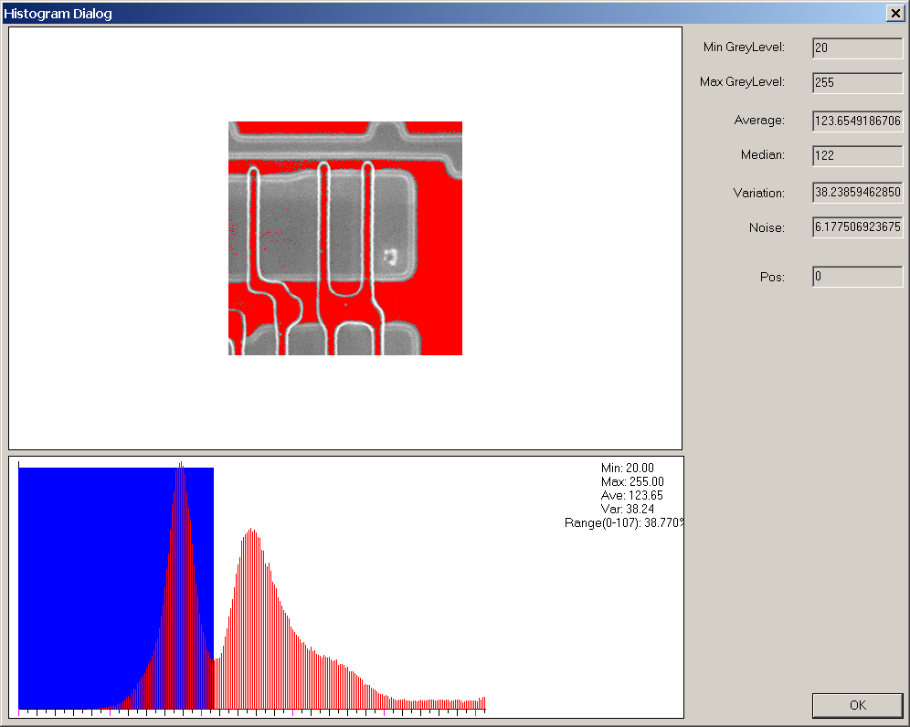
Inspection Principle
6. BG Balance
0
128
255

Slide 25
Inspection Principle
7. Detection Option:
Fixed sigma:
Image’s sigma is changed based on image. If we ignore this change, we can use a fixed sigma to treat all inspection images. It will reduce some sensitivity and introduce some background change’s false defect. If we increase threshold, the result will be more repeatable.

Slide 26
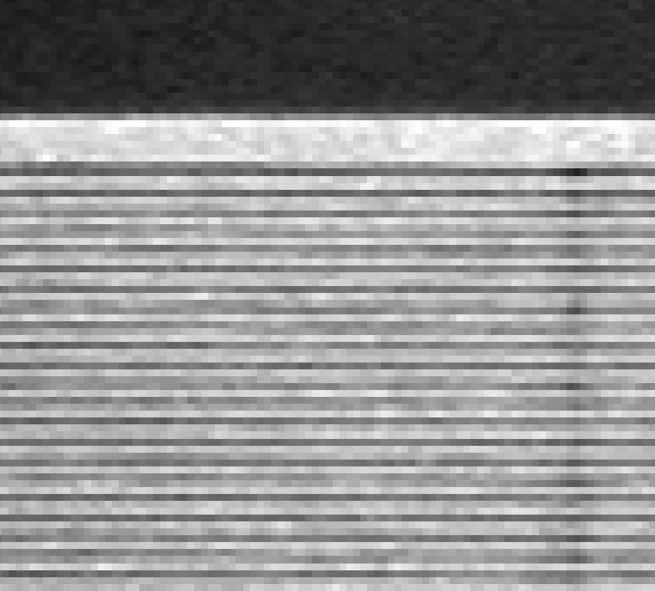
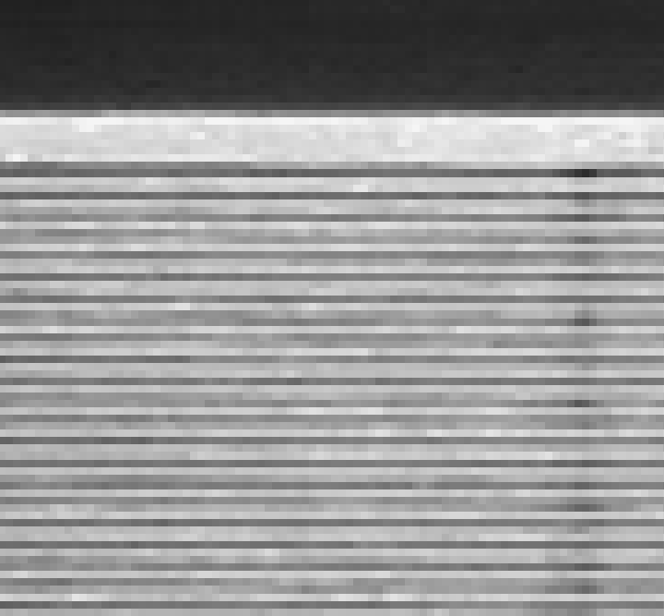
Inspection Principle
7. Detection Option:
Denoise:
If this option is selected, the inspection image will be denoised before detection. Denoise option can reduce image’s white noise. For most images, this option is very useful to reduce image noise before detection.

Slide 27
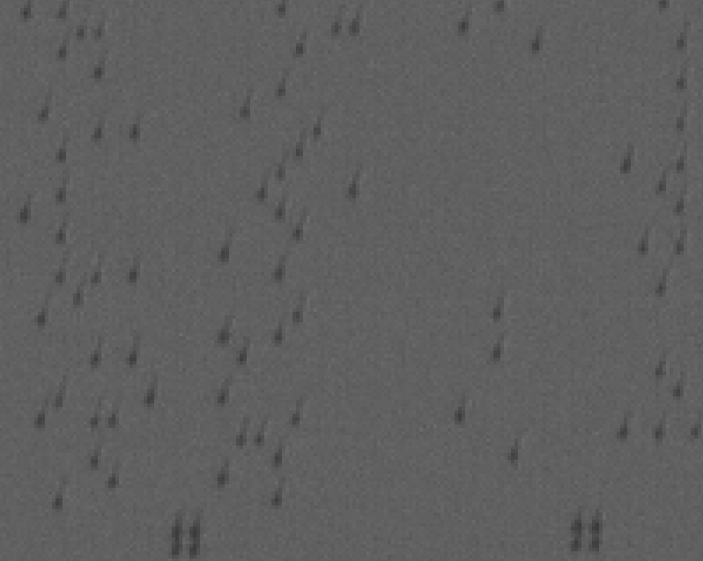
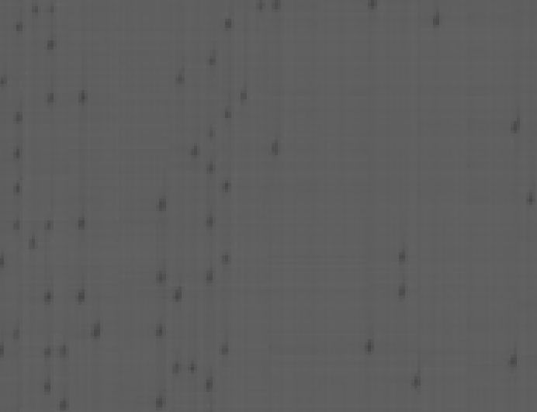
Inspection Principle
7. Detection Option:
Denoise: (conts.)
In some cases like image contrast is not enough, and pattern is very small (related to pixel size). This option will cause some artificial issues.

Slide 28
Inspection Principle
7. Detection Option:
Redetection:
When Redetection option is selected, the patch image will be realigned during about 8 pixels range again. After realignment, the patch image will do detection again. When the redetection’s strength is less than 0.9 times of original strength, this defect will be filtered out.
Redetection option can reduce some misalignment defect because of image distortion.
For array mode, if period is less than 8 pixels, DONOT use redetection option. Because redetection option will filter out all defects.

Slide 29
Inspection Principle
8. Alignment Range
Alignment range is the range which alignment algorithm will search the best alignment point. So if image shift is bigger than alignment range, alignment algorithm will give out a wrong alignment result which will cause a lot of misalignment.
Common misalignment root causes:
8.1 Stage moving error or die registration error
it will cause image shift bigger than alignment range.
For eScan380, this error should be less than 0.3um.
8.2 Image distortion cause image non-linear shift
If non-linear image distortion, image stripe/column will locally misalignment
8.3 Alignment algorithm lock to wrong lock point
Interlace or array pattern more easily misalignment. It depends on pattern

Slide 30
Inspection Principle
9. Special Filter Kernel effect
Sensitivity parameter can automatically control filter kernel. But we can skip sensitivity parameter to control filter kernel to get some special inspection effect.
For example, metal line’s BVC or DVC, we are just interesting in broken point. For normal inspection, we can catch a lot of BVC or DVC defect from metal line. If we use the following filter kernel, we will be able to catch only broken point defect.
0 | 0 | 0 | 0 | 0
1 | 0 | 0 | 0 | -1
1 | 0 | 0 | 0 | -1
1 | 0 | 0 | 0 | -1
0 | 0 | 0 | 0 | 0

Slide 31
Thank You !!

